Slide 1
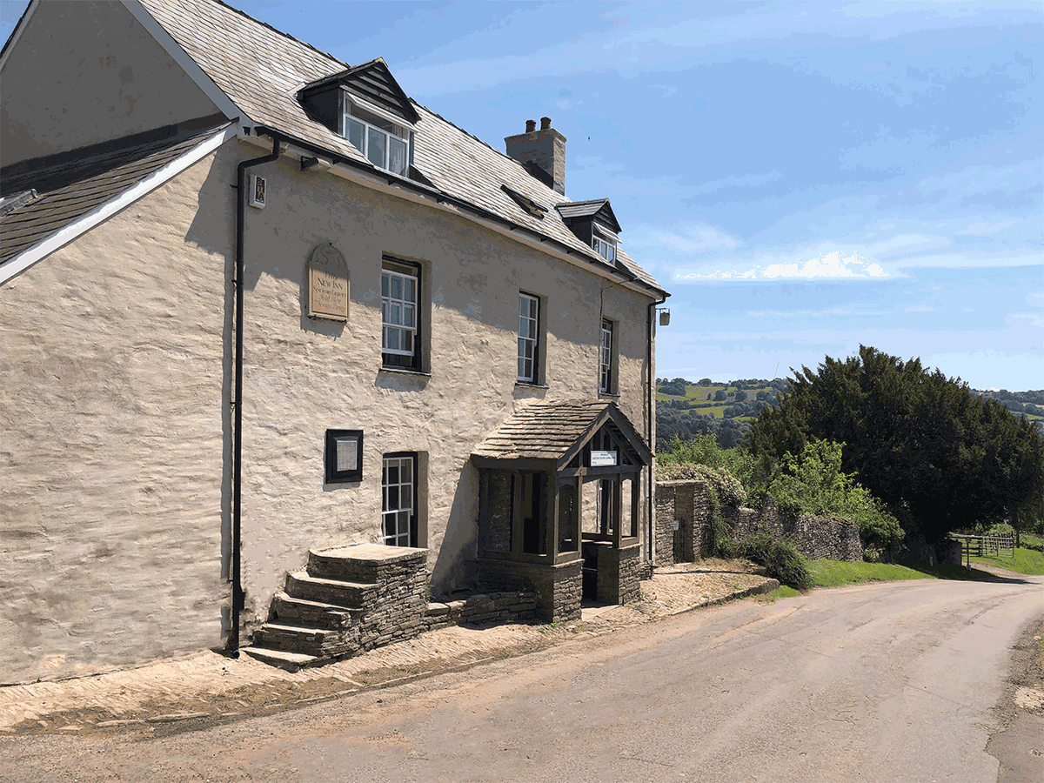


Broughton Primary School
Year 6 Residential
2025
Longtown
Outdoor education Centre
Herefordshire

Slide 2
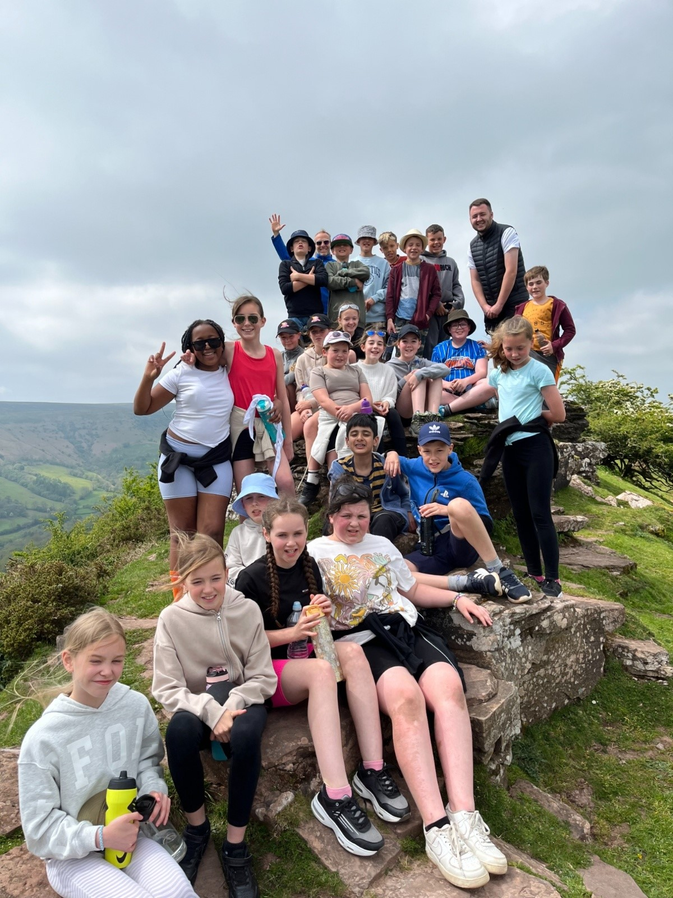
teamwork and communication independence resilience problem solving
Celebration!
AIMS

Slide 3
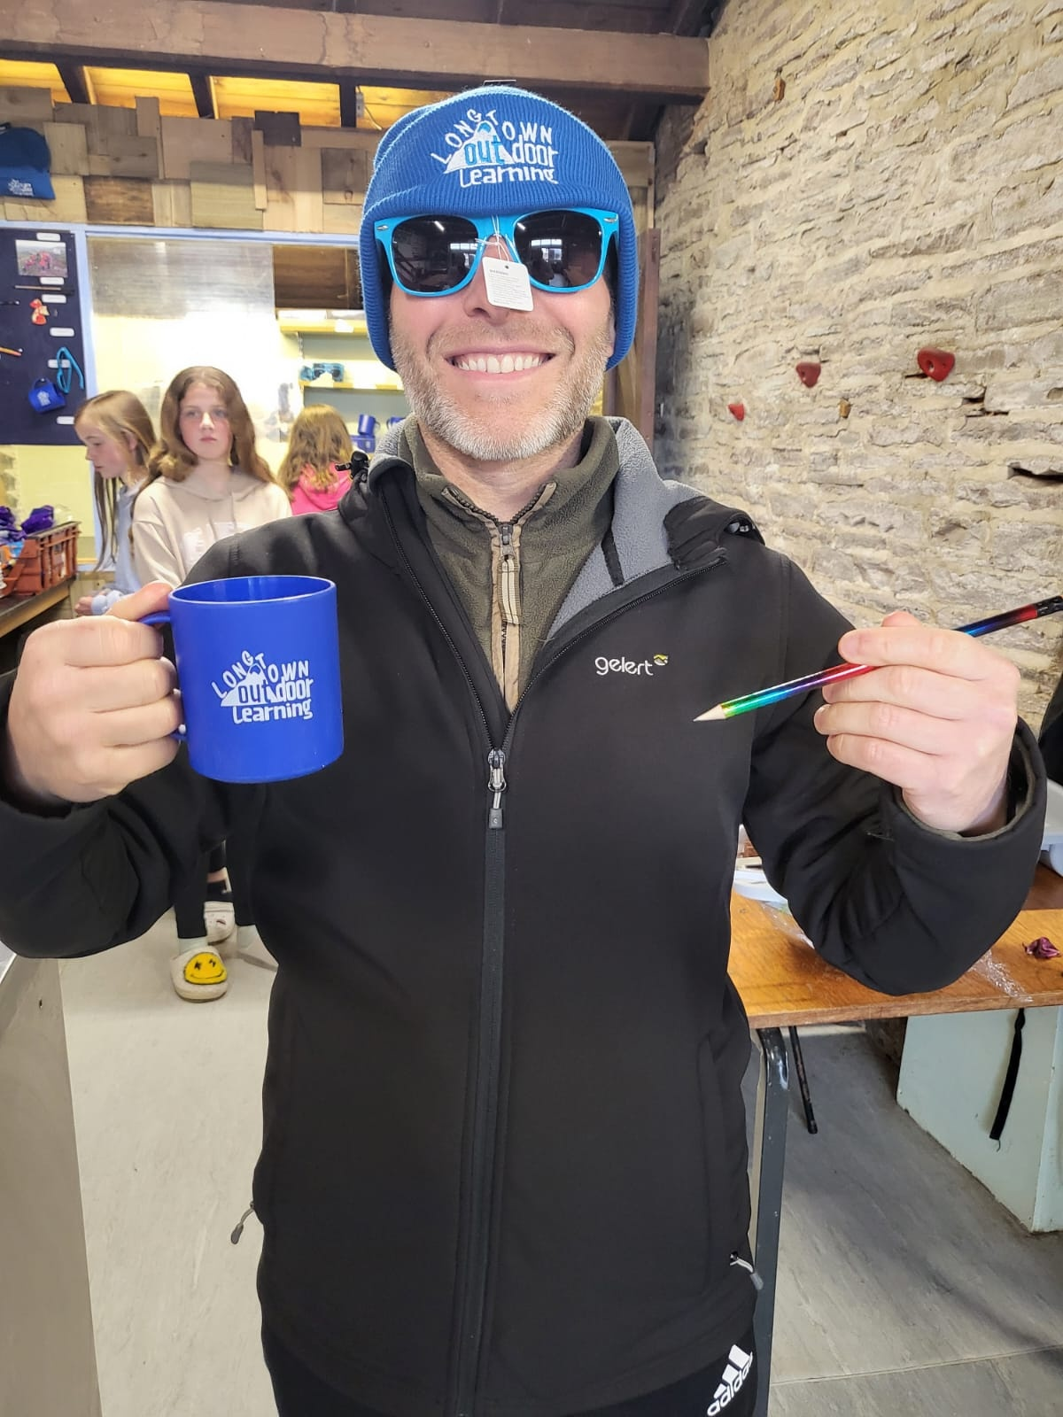
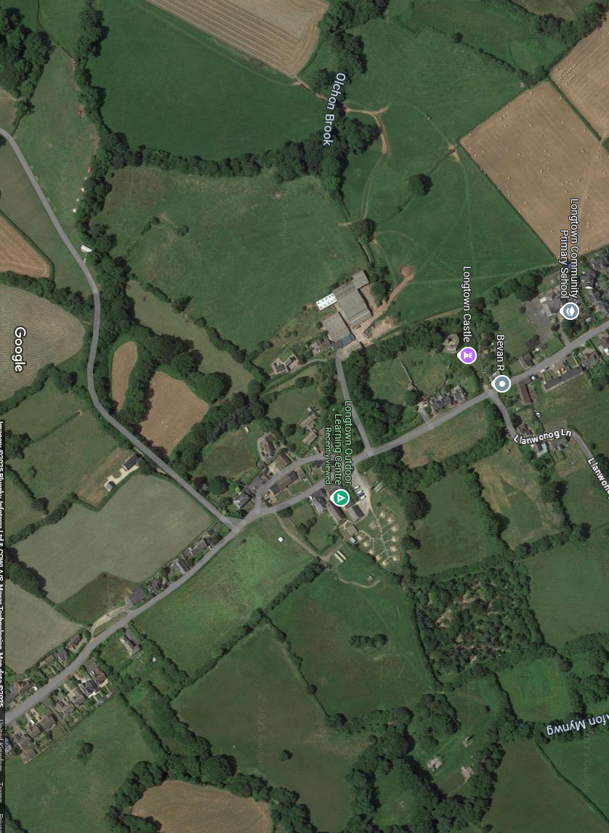
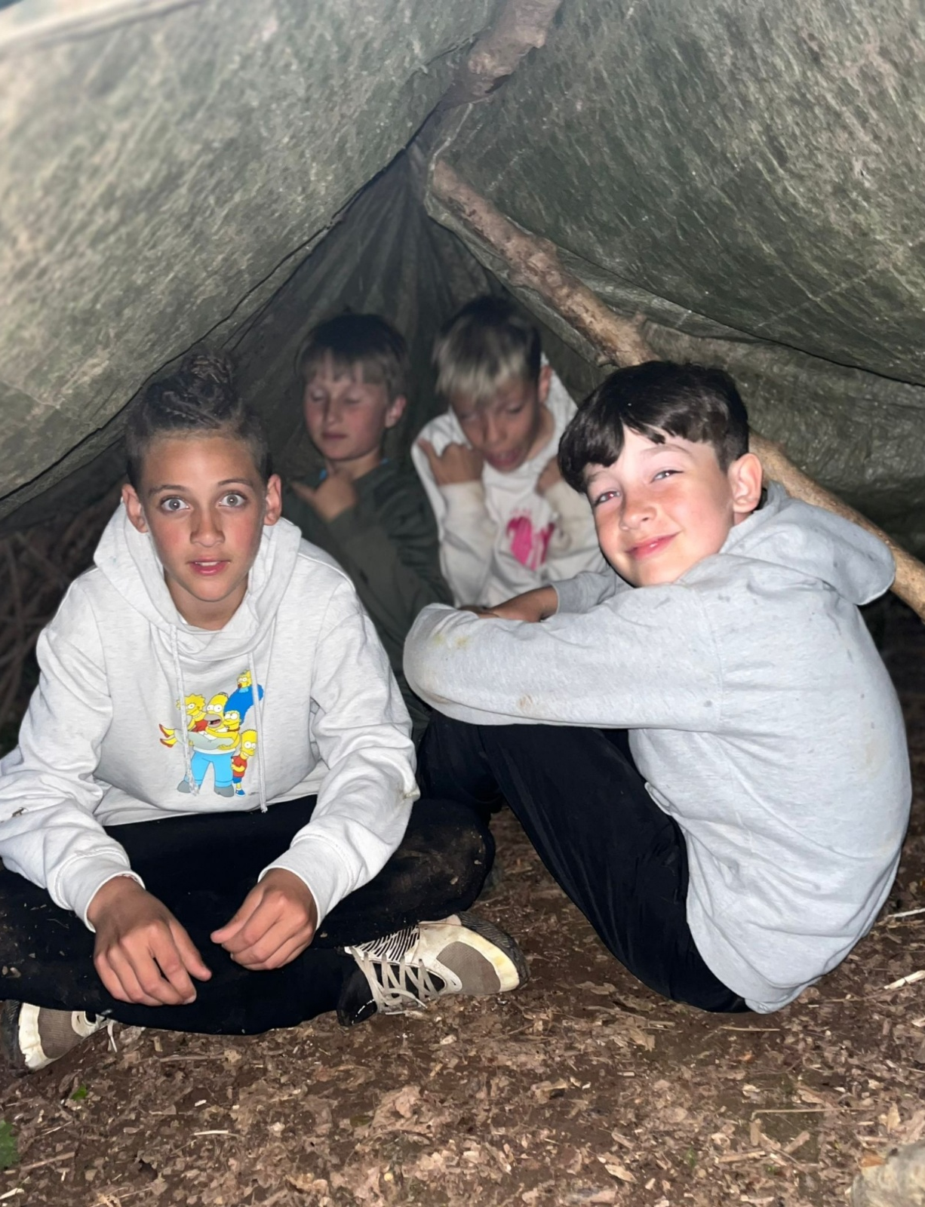
Agenda
Monday 19th May
Leaving BPS – Meet in Year 6 classroom 7.45.
Give all forms and medication to staff.
Bring lunch in a disposable bag, have this in your back pack.
Friday 23rd May
Returning to BPS depart from
Longtown 10.30 am
Arrival at BPS- approximately 3-4pm.
Text will be sent
Have we got your correct mobile number?

Slide 4
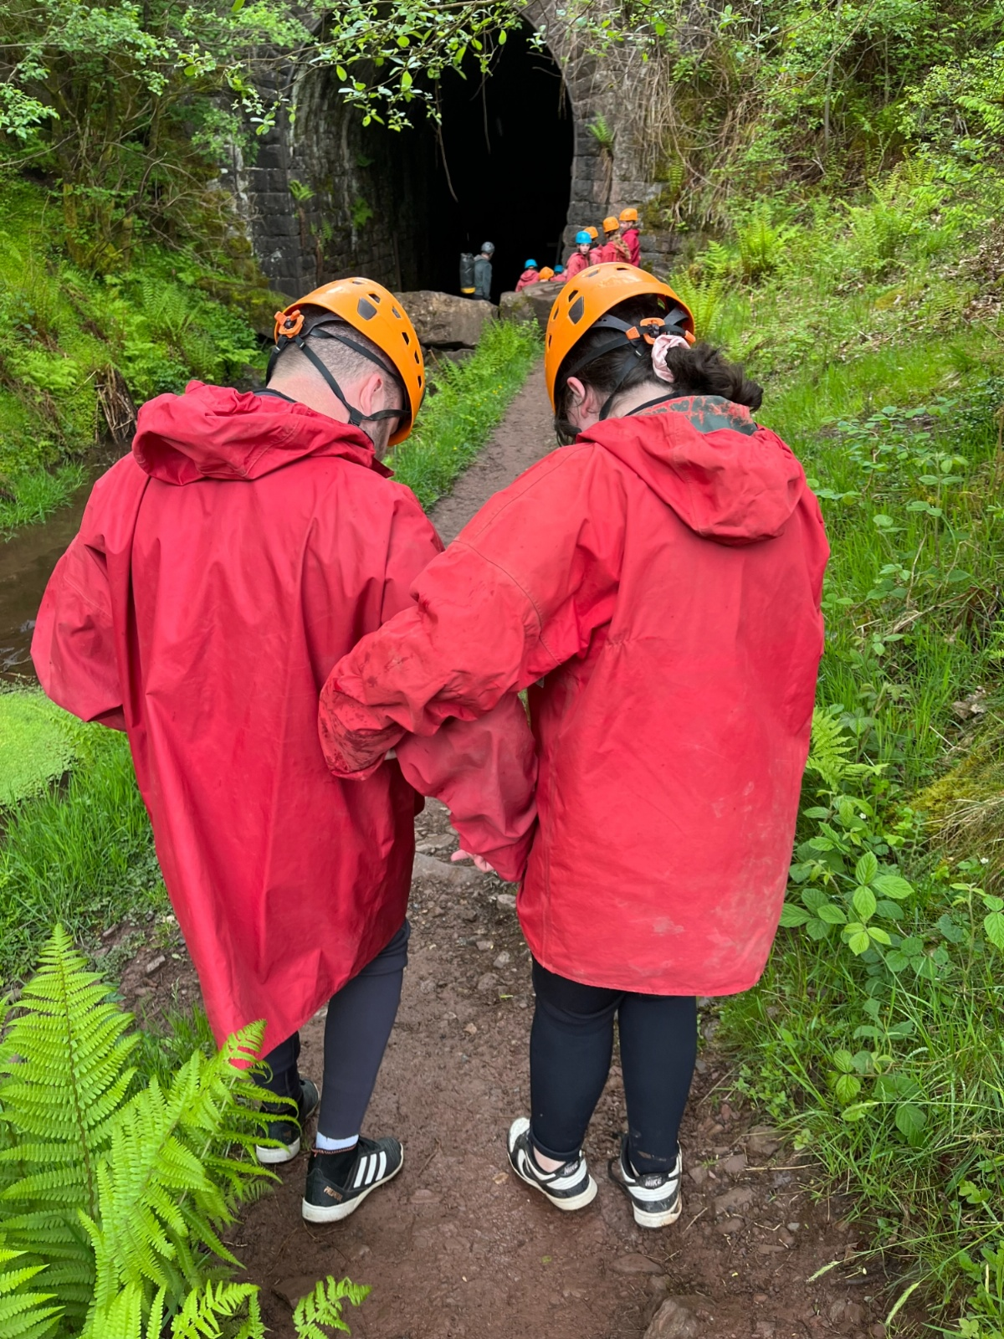
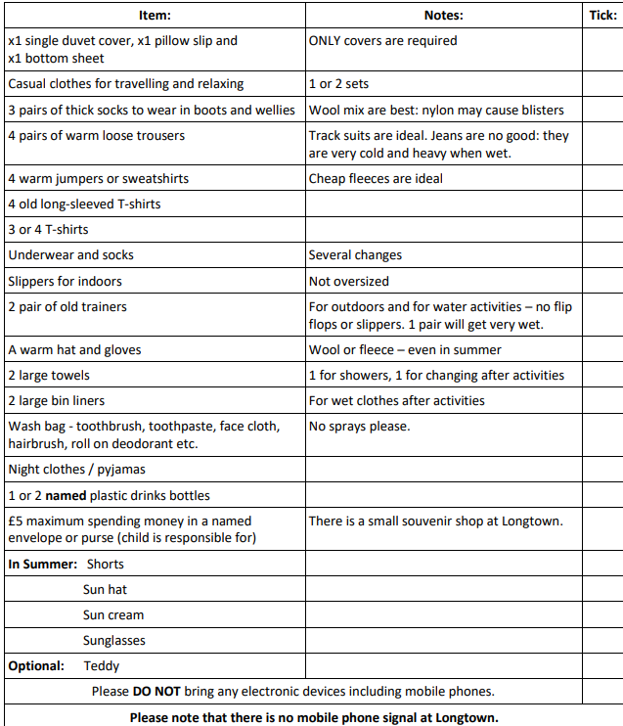
Kit List

Slide 5
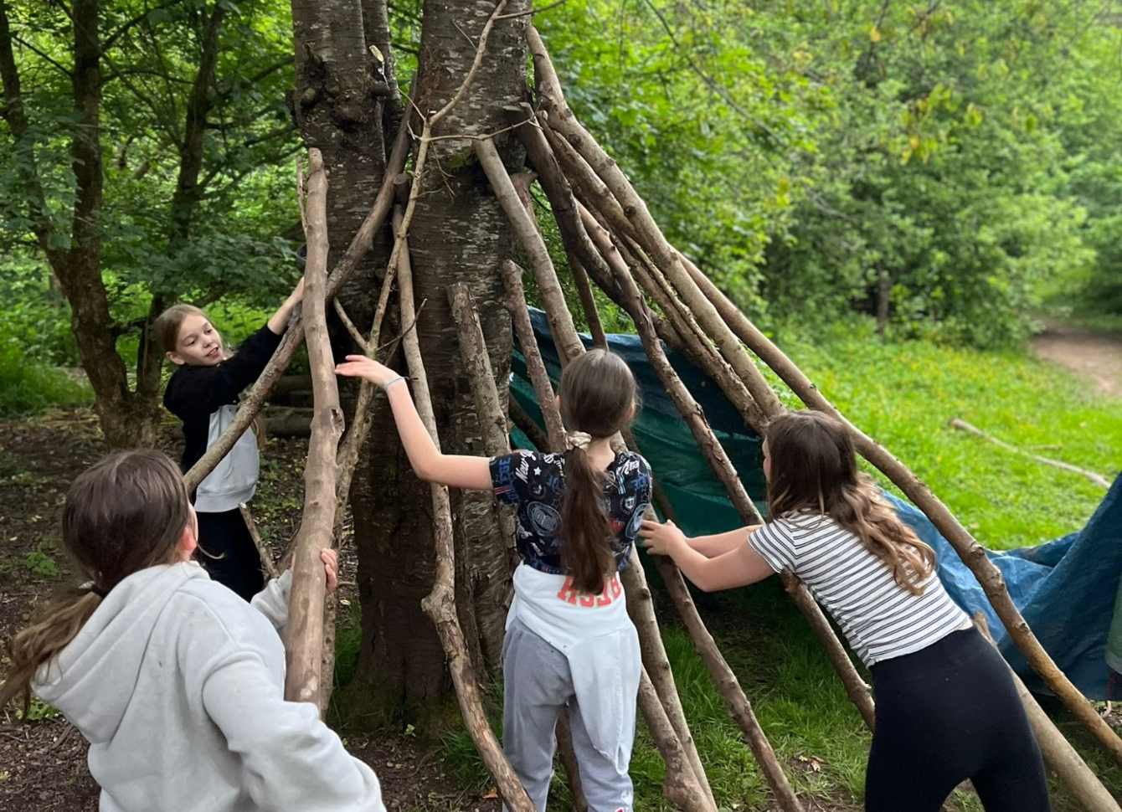
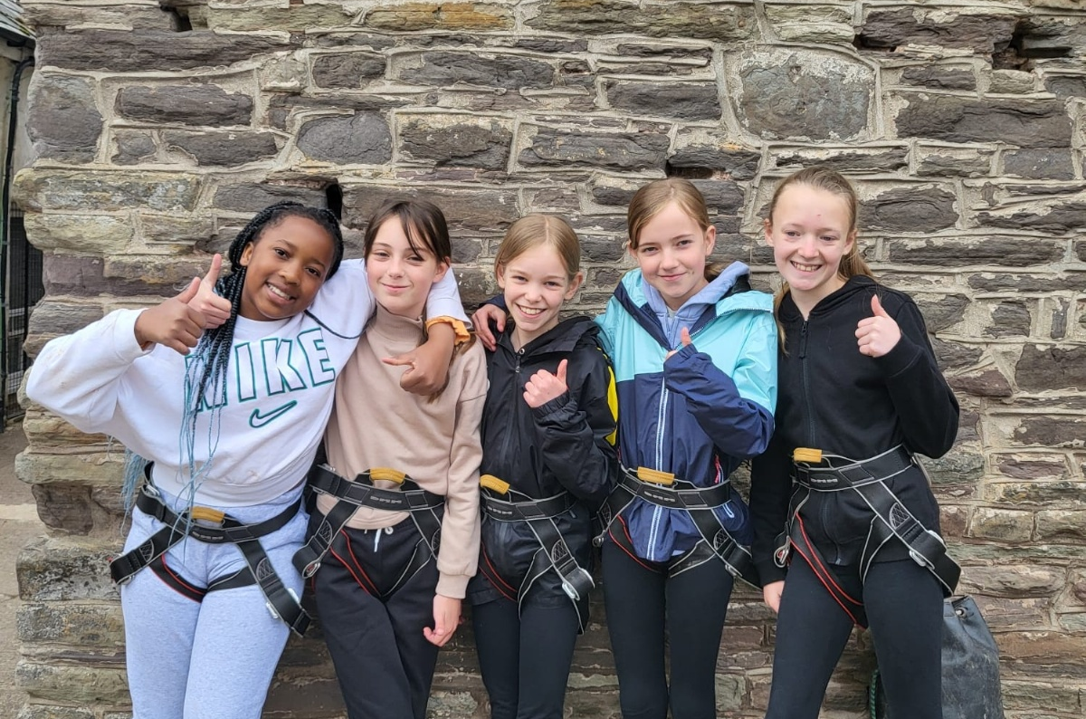
Extra kit
Children may bring books, crayons, colouring books.
No phones, tablets, electronic devices.
No snacks, food, drinks other than water.
Shampoo and bodywash (No aerosol deodorants, hair spray, etc)
Medicine needs to be clearly labelled with name and dosage instructions and handed to a member of BPS staff on arrival.
Remember a plastic bin bag for dirty/wet clothes.

Slide 6
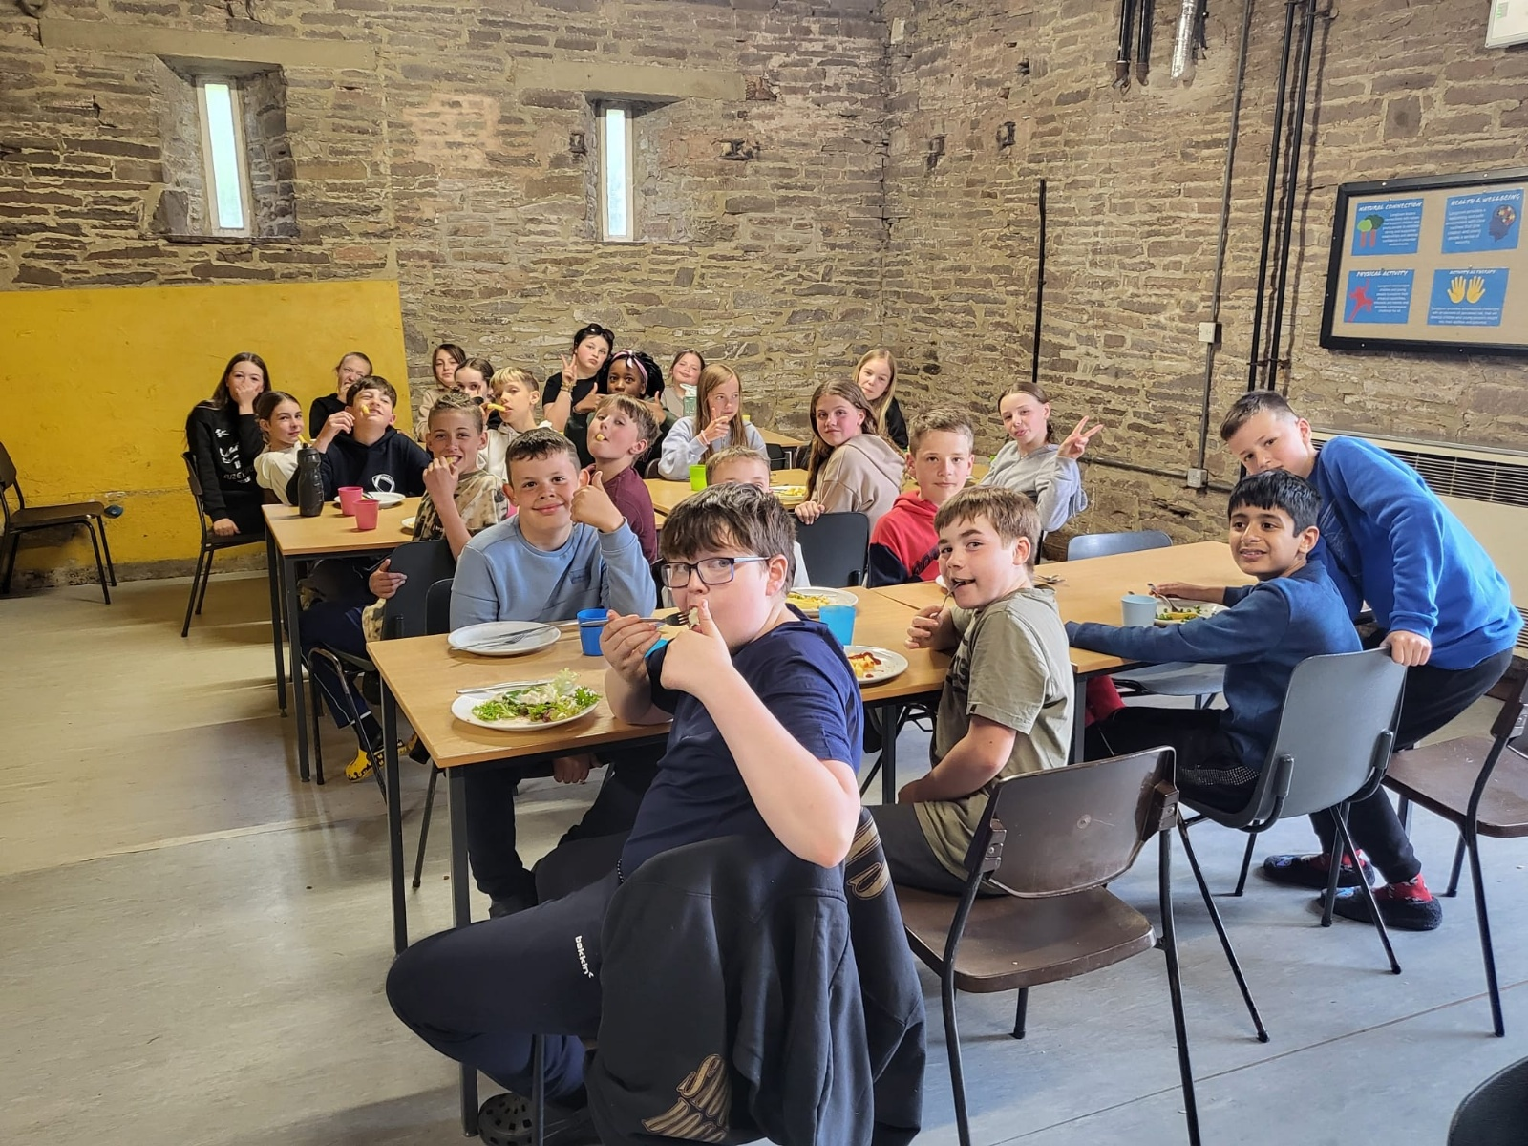
Food
Great selection of food, healthy food for hungry children
Menus for children with allergies and dietary requirements.

Slide 7
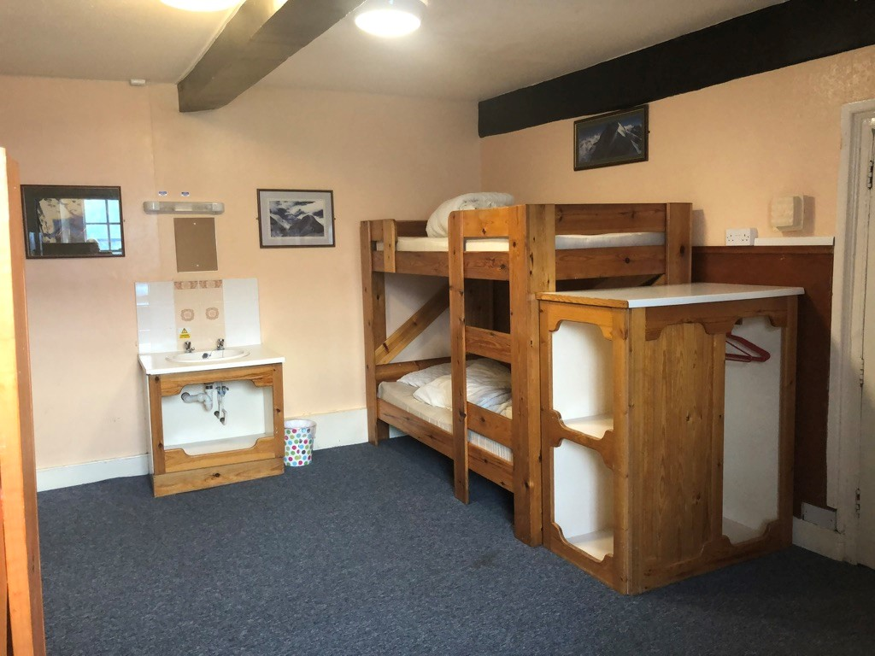
Accommodation
3-6 children per room.
Some rooms are en-suite with shower, shower block /toilets near.
Staff will be in rooms on the same corridor.
Children will have to make their own beds.

Slide 8
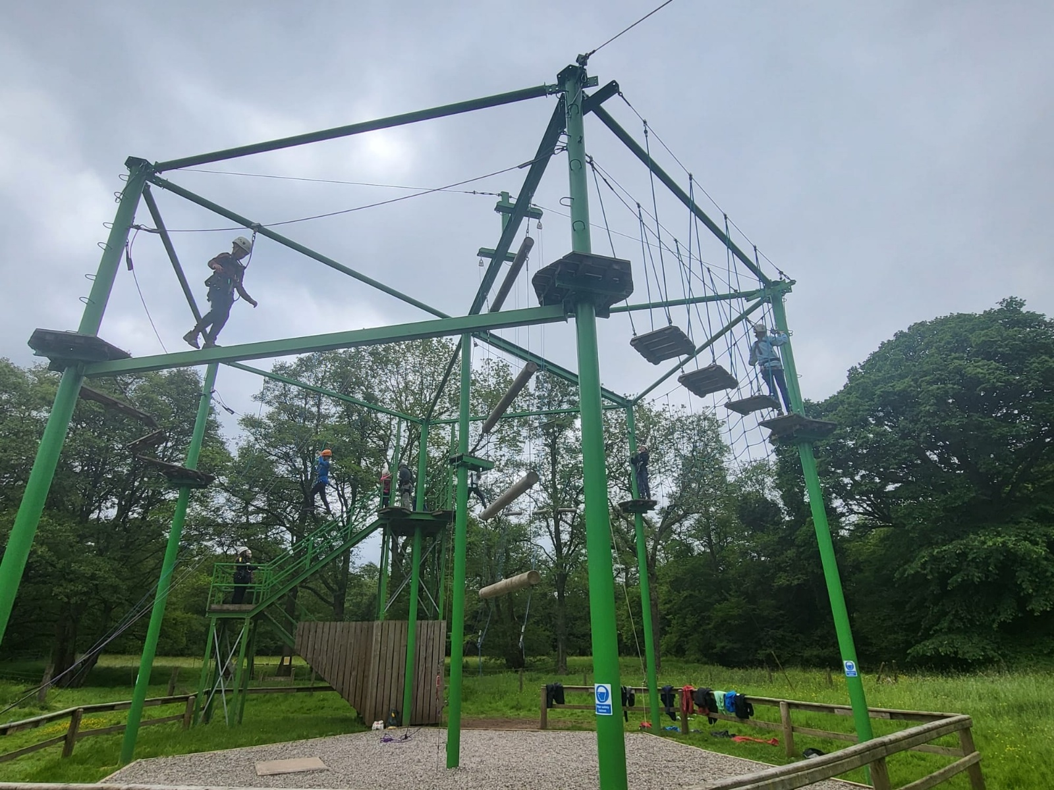
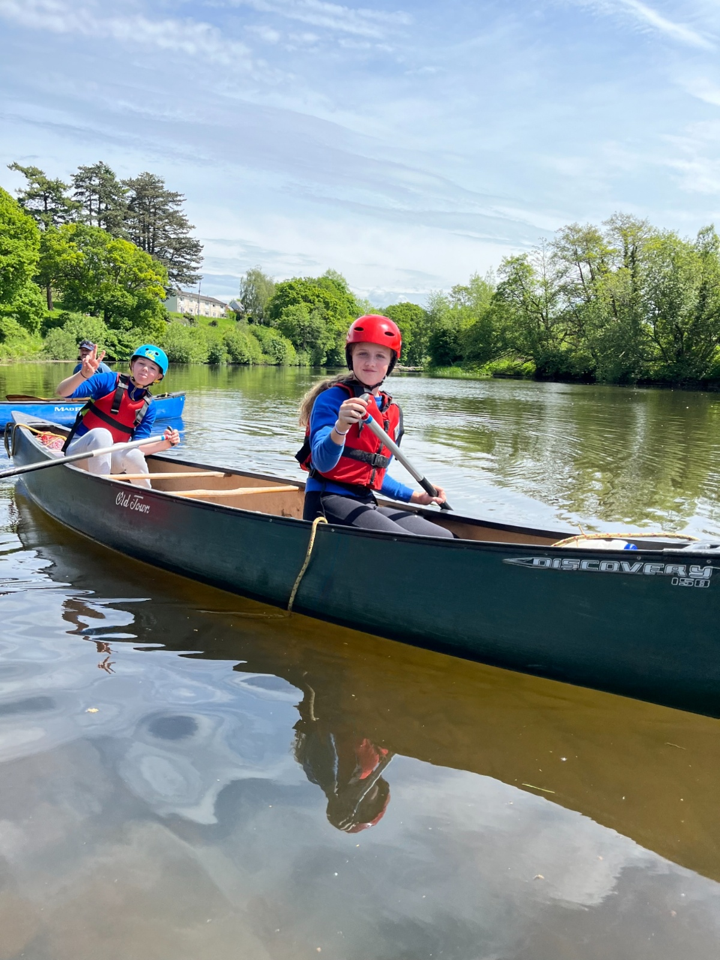
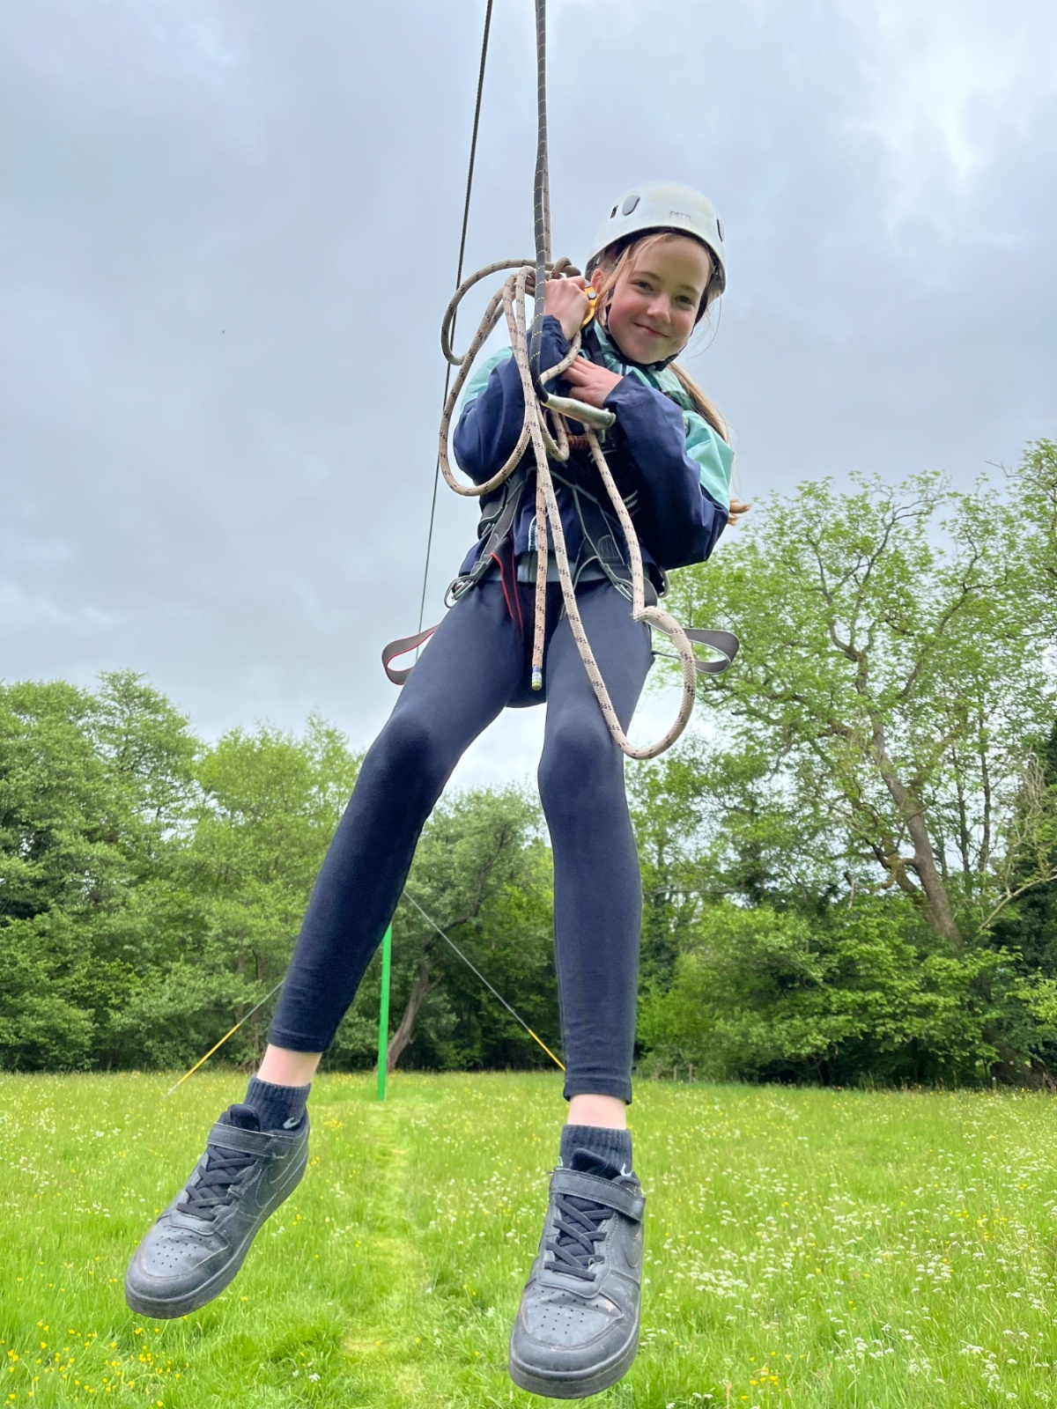
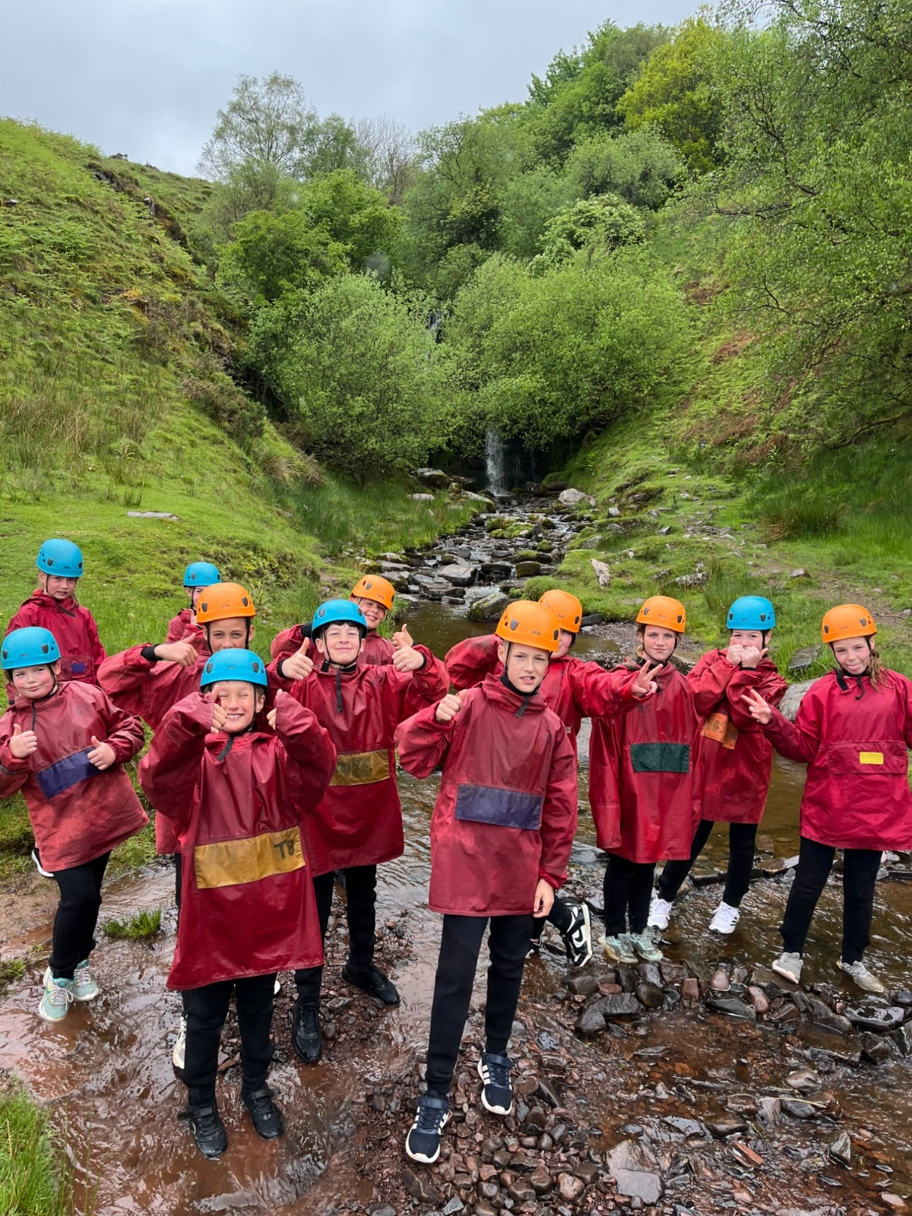
ACTIVITIES
Be ready for a time to remember!

